Slide 1
Visual Studio 2019 Tips & Tricks
Kristina Trojáková 1/2020

Slide 2
Introduction
Change Visual Studio language on English (is easier find and especially easier to set up what you want).
Visual Studio has really many options how you can customize or improve basically all.
Many keyboard shortcut can find in Visual Studio when you place the cursor on icon. If you see shortcut like Ctrl + K, Ctrl + E in fact it means Ctrl + K,E!

Slide 3

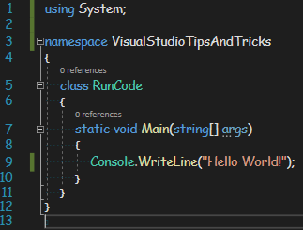
You can run your program by pressing F5 button instead mouse click on this or you can press Ctrl + F5 (this disable debugger).
Ways how you can run your program
If you run this code by pressing on F5 button or mouse click on popup window is opened and closed so fast you really don‘t see anything.
If you disable debugger (that means you run this code using Ctrl + F5) popup window is opened but not closed.

Slide 4

Code snippets
Code snippets are ready-made snippets of code you can quickly insert into your code.
You use them by typing name (or shortcut) snippet and then double press Tab button.
Few examples
cw => create Console.WriteLine();
for => for loop (increments the loop variable after each iteration)
forr => reverse for loop (decrements the loop variable after each iteration)
equals => create a method declaration that overrides the Equals method defined in the Object class (try it yourself ).
List of all default snippets
Instruction how create own snippets

Slide 5
Bookmarks
Do you have some part of your code that works, but different than you need and you don’t have time to fix it right now?
Or you want to change some of the code, but you just have to do something else?
Maybe you working with long files and you want to change some part of code on line 75 - 81 and then you need check something on line 5 – 9 ant then go back to line 75 and then go back and so on.
Note: Video bellow is for VS 2013 and shortcuts for VS 2019 are different.
For open Bookmarks window: Ctrl + K,V; for set up bookmark Ctrl + K,K
For move to the previous bookmark: Ctrl + K,P; for move to the next bookmark: Ctrl + K,N
Bookmarks introduction video

Slide 6
Toolbox
Do you have some part of your code or some function that you use often in multiple projects?
Good news, you don’t have to write the same code every time when you need it, just use Toolbox. If you don’t see this bookmark in your Visual Studio press Ctrl + Alt + X.
Now just select some code and drag it into the Toolbox and that’s it you have code ready to go at anytime.
Detailed instructions

Slide 7
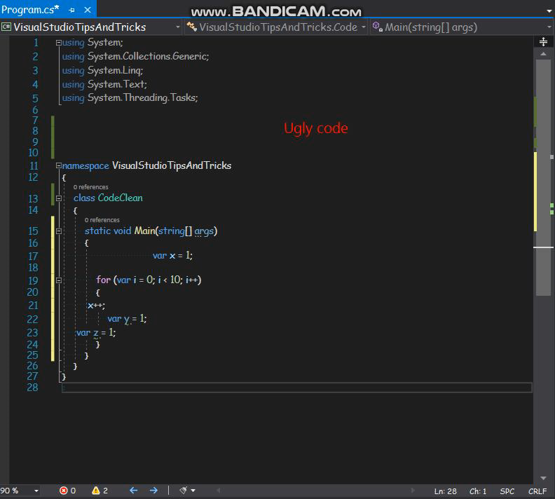
Cleanup your code

Slide 8
Few keyboard shortcuts
Ctrl + Q → find everything you need in Visual Studio (setting, projects, …)
Ctrl + R,R → rename all the references to the variable
Ctrl + E,V → duplicate line of code
Ctrl + K,C → comment selected line
Ctrl + K,U → uncomment selected line
Shift + Alt + = → expand selection
Shift + Alt + - → contract selection
Alt + Enter or Ctrl + . → fixed code errors inline
Shift + Alt + Enter → full screen view (on, off)
Ctrl + M,M → collapse or expand block of code

Slide 9
Thank you for your attention

